Slide 1
Alcohol Beverage Industry
Vertical Training

Slide 2
TODAY’S AGENDA
The Advertiser
Key Focus
LISTEN, TALK, SHARE
Pitch Tips
Stand Out Tactics
Questions?

Slide 3
The Advertiser & Vertical Research

Slide 4
Who Falls into the Beverage Category?
Liquor Stores
Grocery Stores
Convenience Stores
State-wide distributors: IBA, INBEV
Local/Regional Distributors
Non-Alcoholic

Slide 5
ALCOHOLIC BEVERAGE TAKEAWAYS
MARKET AFFINITY
INCREASED CONSUMPTION
FACTORS OF CONSIDERATION
MOVE TO DIGITAL
80% of those of drinking age in the U.S. consume alcohol and consume 3+ glasses/week– this leaves an enormous target audience for the industry. Brands will need to create unique segments to ensure they are targeting their advertising dollars effectively.
Alcohol consumption increased during the pandemic and among WFH positions. Tequila consumption appears to be on the rise, yet beer and wine remain most common.
Alcoholic beverage consumers aren’t extremely brand loyal. Their purchases are driven by taste, recommendations, and availability. More established brands must also consider this as they try to retain their current consumers and these customers desire to purchase online or looking for delivery services.
The alcohol industry is one of the slowest to transition to digital advertising. As the 21+ population comes from digital-native populations, the industry will need to adapt to a digital-focus.
Among digital ad buys, most come from programmatic means.

Slide 6
RESEARCH
ALCOHOL INDUSTRY
80% of Americans of legal drinking age drink alcohol
Beer & wine are the most popular drinks. Still, 44% of Americans of legal drinking age drink RTD (ready-to-drink) alcoholic beverages as convenience has become a higher priority
63% of alcohol retailers are planning on making more room for hard seltzers on their shelves, with retailers showing specific interest in White Claw, Truly & High Noon
68% of alcohol retailers expect tequila to be in higher demand in the next year
As of November 7, 13% of Americans report consuming more alcohol in order to cope with stress during the pandemic
As of November 7, 22% of remote workers have reported drinking more alcohol since working from home
Source: Lightspeed, Mintel, The Harris Poll

Slide 7
Delivery & online sales have become the future of the alcoholic beverage industry.
Delivery has been the leading service offered by retailers who transact online, with 36% using the service.
As of October, Drizly’s alcohol delivery platform saw a year over year growth of 350%. In this time there, was a 30% increase in average order value.
70% of independent retailers surveyed experienced higher in-store alcohol sales since the pandemic started, while 78% saw higher online sales.
56% of alcohol retailers now have their online sales account for more than 11% of their sales.
Source: Drizly, Spirits Business

Slide 8
ALCOHOL RETAIL SALES HAVE DRAMATICALLY SHIFTED ONLINE SINCE THE START OF COVID
TLG EXECUTIVES
Percentage of Alcohol Sales Through Online Platforms
Key Implication
Online alcohol sales have increased due to the pandemic.
As consumers become more comfortable and regular with purchasing alcohol online, paid digital media would likely drive the highest conversion rates and have the best ROI.
Source: Drizly

Slide 9
THE MONTHS WITH PEAKS IN AD SPEND CORRELATE WITH THE MONTHS CONSUMERS ARE MOST ENGAGING WITH BRANDS
Monthly Alcohol Industry Ad Spend Trends
January 2020 – April 2021
Key Implication
Monthly advertising investment in the alcohol industry peaked in December 2020. During this month, there were many holiday & safety-focused campaigns. 2021 monthly ad spend has exceeded the amounts spent in the same months in 2020.
As we enter Q4 2021, we can expect ad spend, especially digital to increase drastically in the alcohol vertical.
Source: Kantar Media
*Total Ad Spend includes TV, magazine, newspaper, radio, internet display, mobile web, online video, Facebook mobile, internet search, and outdoor ad spend

Slide 10
THE ALCOHOLIC BEVERAGE INDUSTRY IS AN IMMENSELY LARGE SPENDING VERTICAL BUT IS FOCUSED TOO HEAVILY ON TRADITIONAL MEDIA. THE WINE SEGMENT IS LEADING THE WAY IN TRANSITIONING AD SPEND TO THE DIGITAL FORMAT. STILL, THEY ARE FAR BEHIND OTHER SEGMENTS IN USING PROGRAMMATIC BUYING METHODS.
NOV 2020 – APR 2021 | TOTAL ALCOHOL | BEER | WINE | SPIRITS
TOTAL AD SPEND | $ 999.39 Million +7% from prior 6mo. | $674.53 Million +2% from prior 6mo. | $58.54 Million +18% from prior 6mo. | $281.97 Million +29% from prior 6mo.
TRADITIONAL AD SPEND | 84% | 85% | 71% | 75%
DIGITAL AD SPEND | 16% | 15% | 29% | 25%
DIGITAL MEDIA TRANSACTION TYPE | Ad Network/Direct: 17% Programmatic: 83% | Ad Network/Direct: 12% Programmatic: 88% | Ad Network/Direct: 63% Programmatic: 37% | Ad Network/Direct: 6% Programmatic: 94%
TOP BRANDS BY TOTAL AD SPEND | Budweiser Corona Michelob | Budweiser Corona Michelob | Kim Crawford Meiomi Freixenet | Crown Royal Grey Goose Jack Daniels
Source: Kantar Media

Slide 11
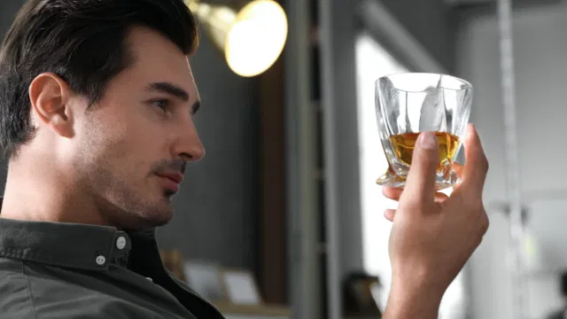
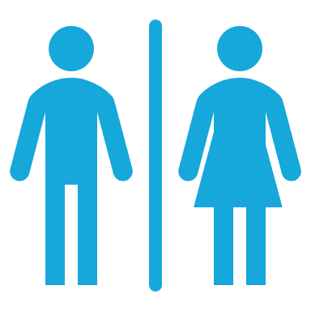
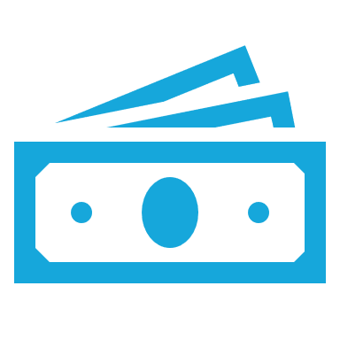
FREQUENT SPIRITS DRINKERS ENJOY LIQUOR WHEN SOCIALIZING AND ENTERTAINING OTHERS AT HOME, OTHERWISE THEY DRINK BEER & WINE
Adults 25-54
Men
Married
College Educated+
HHI $75K+
While I frequently drink spirits, I more often drink other types of alcohol | TARGET 2
I typically drink other alcohol more than spirits | Key Implication: Brands need to know that their product is not the consumer’s first choice so they must promote situational drinking
I usually drink spirits in a mixed drink, not straight | Adults X Men/Women Married College Graduate HHI
I typically purchase what’s most popular | X X
Entertaining others at my home is an important part of my social life and spirits consumption habits | TARGET 2
I enjoy showing off my home to guests | Key Implication: Spirits advertisers should use images of consumers at social events like dinner parties hosted in a home
I’m more likely to drink spirits at social gatherings | Adults X Men/Women Married College Graduate HHI
I usually drink spirits at home | X X
I like to lead a sophisticated and cultured life | TARGET 2
I consider myself sophisticated | Key Implication: Spirits brands should consider advertising on global news sites as their target is long periods of time there
I like to learn about foreign cultures | Adults X Men/Women Married College Graduate HHI
To me, it is important to keep up-to-date with news and current affairs | X X
I like trying new foods & drinks – there is nothing like discovering a new brand | TARGET 2
Risk-taking is exciting to me | Key Implication: As the industry expects tequila consumption to increase, brands won’t have trouble convincing spirits drinkers to try their product
I enjoy trying different types of food | Adults X Men/Women Married College Graduate HHI
I frequently try new brands of spirits | X X
I work very hard to achieve my goals at work and it has paid off as I gain higher leadership in my career | TARGET 2
I consider my work to be a career, not just a job | Key Implication: Another key place of consumption for spirits drinkers may be with their co-workers and clients for networking
I often find myself in a leadership position | Adults X Men/Women Married College Graduate HHI
I would love to be happy to be my own boss | X X
I value quality and want to purchase the best of the best | TARGET 2
I highly value wealth and material possessions | Key Implication: Spirits consumers are willing to spend more for higher quality product so brands, no matter the price point, need to explain why their product is the best
I am typically willing to pay more for high quality items | Adults X Men/Women Married College Graduate HHI
I’m typically willing to spend more for a quality bottle of alcohol | X X
Source: MRI Market-by-Market 2020

Slide 12
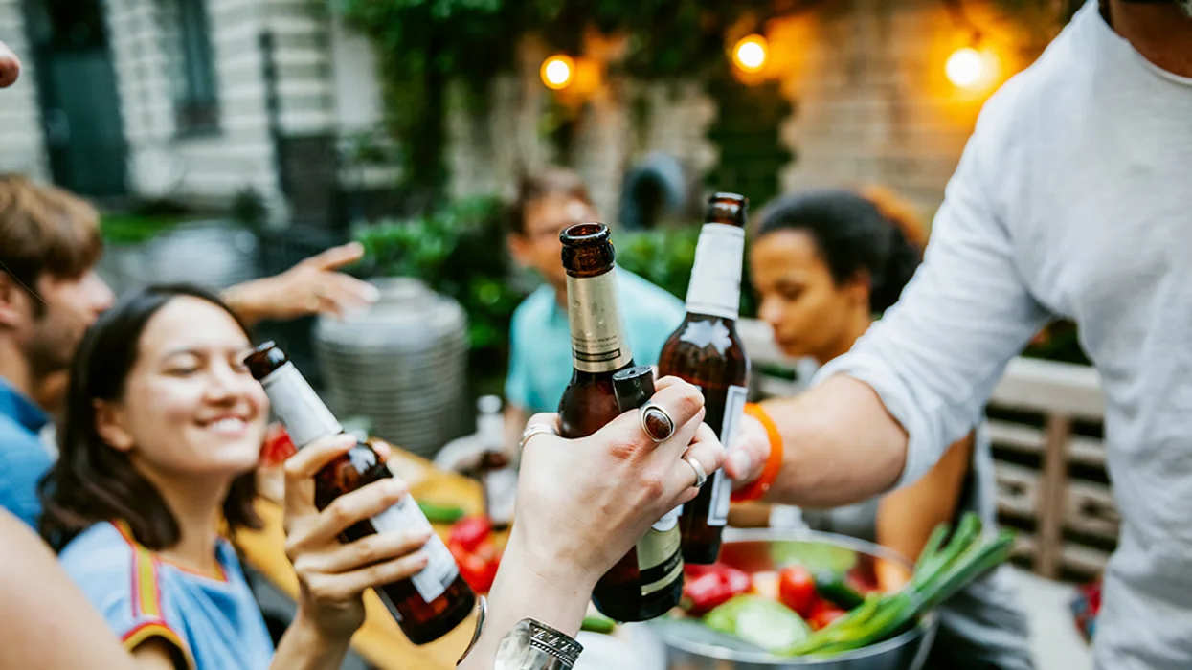
FREQUENT DRINKERS
Device Ownership
92% own a smartphone
56% own a tablet
60% own a smartTV or internet-connectable device for TV
Spends
26
hours/week
online
Mobile
65% use mobile apps
50% search for information about a product on their smartphone
41% purchased a product on their smartphone
44% watch videos on their smartphone
Search
90% uses any search engine
87% uses Google
66% use a search engine on their smartphone
Streaming
73% use a video streaming service
23% use Hulu
67% use an audio streaming service
25% listen to podcasts
34% use Pandora
24% use Spotify
Social
84% use a social media
52% use social media on their smartphone
54% watch videos on social media
56% use YouTube
67% use Facebook
37% use Instagram
17% use Twitter
Source: MRI Market-by-Market 2020

Slide 13
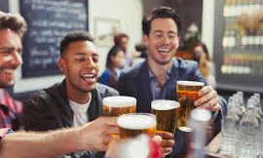
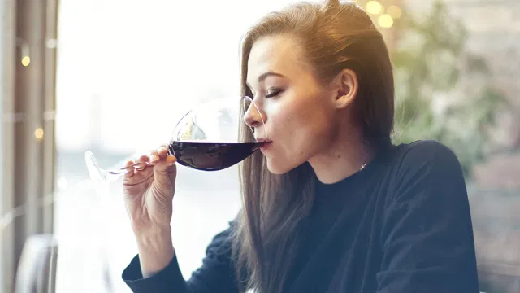
ALCOHOLIC BEVERAGE CONSUMERS
 | FREQUENT ALCOHOL DRINKER | FREQUENT BEER DRINKER | FREQUENT WINE DRINKER | FREQUENT SPIRITS DRINKER
SIZE | 130,696,000 | 68,094,000 | 59,434,000 | 76,836,000
DEMOGRAPHICS | Adults 25-44 Men Married College Graduate+ HHI $75K+ | Adults 25-64 Men Married College Educated+ HHI $75K+ | Adults 45+ Women Married College Graduate+ HHI $75K+ | Adults 25-54 Men Married College Educated+ HHI $75K+
CHALLENGE | Less drinking at home Larger share of consumers are trying to reduce alcohol consumption after COVID | Even beer consumers are trying make healthier decisions Still, light beer sales are on the decline and projected to continue the decline | Drinking alone at home is decreasing Not strong brand loyalty – just loyal to wine variety/color | Not strong brand loyalty – often trying new brands Home consumption will decrease as people go out more
OPPORTUNITY | Happy Hour after work Drinking more premium alcohol | Opportunity for smaller and specialized brands to grow Family/friend gatherings: summer BBQs Sports: MLB, NHL | More socialization with friends at home – book clubs, wine nights, etc. Wine drinkers want to learn more about wine | Return of Happy Hours as people go back to the office Restaurant consumption will increase more
MEDIA INFLUENCES | Podcasts Spotify Traditional TV | Spotify Video Games Twitter | Podcasts Magazines CTV | Podcasts Spotify Traditional TV
BEHAVIORS | Flavor is the leading factor when choosing alcohol to purchase Willing to spend more on quality alcohol The type of drinking event drives their drink choices | Typically buys beer at the supermarket Typically drinks domestic beer Enjoys taking risks & seeks adventure | Spends more on a quality bottle of wine Typically sticks to the same varietal of wine Eats healthy & pays attention to nutrition – tries to select the healthiest alcohol option | Flavor is the leading factor when choosing alcohol to purchase Willing to spend more on quality alcohol The type of drinking event drives their drink choices
CONTEXT | Happy Hour after work Trying new restaurants Relaxing/Unwinding | Social drinking – likes being center of attention Drinks beer to relax/unwind Drinks beer a few times/week | Drinks wine with dinner Winds down with wine and TV Drinks wine a few times/week Intermediate knowledge of wine | Happy Hour after work Trying new restaurants Relaxing/Unwinding
OVERLAP | 52% are frequent beer drinkers 45% are frequent wine drinkers 59% are frequent spirit drinkers | 38% are also frequent wine drinkers 58% are also frequent spirits drinkers | 43% are also frequent beer drinkers 60% are also frequent spirits drinkers | 52% are frequent beer drinkers 45% are frequent wine drinkers 59% are frequent spirit drinkers
Source: MRI Market-by-Market 2020

Slide 14
Key Focus

Slide 15
Important Pieces to Identify for Beverage Advertisers
Consistencies we see across all of beverage clients.
AUDIENCE
PERFORMANCE
LOCATION(S)
Within the beverage categories audiences may overlap or may be drastically different from one another. Identifying the key lucrative audience for an advertiser will be key.
In an industry that often comes with little research before purchase and frequent consumption, launching a campaign with “always on” features that maintain top of mind awareness while promoting incentives to buy are a must.
If your client has multiple locations that cater to different audiences, you may want to consider larger budgets and several sub-campaigns for your client.

Slide 16
Questions to Ask
Learning About Your Advertiser
What does your best customer look like? Where do they live? What do they buy?
How much is an average ticket from an everyday shopper?​
Why do customer shop from you instead of your competitors? Expertise, prices, selection?
For distributors: What do you hope the community knows about you and how you do business?

Slide 17
Pitch Tips

Slide 18
The Beverage Industry Pitch
Multiple Locations
Warm The Door to Digital
Plan for multiple locations and be realistic about the budget required to effectively reach the audience.
In this industry, traditional advertising has been strong so advertisers will need consultants to educate and inform to the value of digital advertising.
Alcohol consumers are drinking 3+ glasses per week so campaigns should maintain consistent visibility.
Campaign Goals
Strong Call to Action
Learn about campaign goals and set expectations about how digital can help them achieve those goals. Find out what is important.
Discuss metrics like CPCV, CPC, eCPM
Think outside the box with creative messaging, and strong call to actions. For frequent purchasers, unless it is a value proposition to their benefit, “since 1925” won’t make them respond.

Slide 19
Stand Out Tactics

Slide 20
Stand Out Tactics: Alcohol
Below are some targeting options for the alcohol vertical. Display, native, and video assets can be used to execute this targeting. Adjust targeting based on campaign goals and target audience.
Mobile Location Retargeting
Contextual Targeting
Audience Targeting
Retargeting
Reach key areas like college campuses and housing, financial districts, and even high-end residential neighborhoods.
For higher end products, focus on finding audiences through adjacency to content relevant to those key audiences reading about wine fines, craft beers, or luxe spirits.
Wine and beer enthusiasts, those that like to home entertain, and frequent liquor store shoppers, can all be layered to effectively reach targeting audiences.
Re-engage users who have already shown an interest in the advertiser’s products and selection.
NOTE: For alcohol-related campaigns, legal drinking age targeting is required with A21+ audience targeting or LDA compliant contextual segments.

Slide 21
Focus on Video & Audio
For beverage clients who frequently use traditional advertising methods, audio and video can be a way to extend their message and reach across digital audiences.
Extending the reach of that video/audio message with streaming can be enticing and a way for them to focus on price/item.
Talk about the power of reusing that video/audio content for multi-device campaigns.

Slide 22
Retargeting Strategy
Retargeting is an essential part of your beverage. If a consumer visits the craft beer page of the website, why not promote your loyalty program sign up? For visits to specific products, why not tell them about others you have to offer?
This first party audiences can be a great way to create audiences based on site traffic or conversions and re-engage those audiences with relevant creative.

