Slide 1
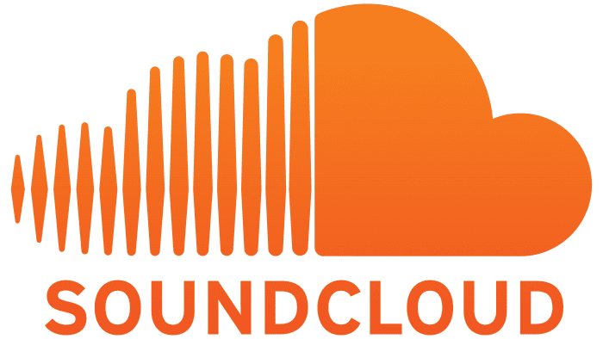
Audio Ads
Reach engaged consumers while they are working out, running errands, or in their car.
THE AUDIO OPPORTUNITY
About two-thirds of the US population ages 12+ listens to digital audio at least once per week.
In 2022, US adults spent more time each day listening to digital audio (1:40) than they did watching subscription video services (1:27) or using social networks (1:15).
- Insider Intelligence, 2022
AUDIO BENEFITS
CAPTIVE AUDIENCE
Users can't listen to anything else while an ad is playing.
HIGHER RECALL
According to Nielsen, audio ads increase ad recall by up to 24% over display.
DECREASE COST & TIME
Reach target audiences at less cost and production time, compared to other media types.
ENHANCED BRAND SAFETY
Access quality inventory, non-skippable ads, and in-app listening to diminish fraudulent activity.
PREMIUM AUDIO INVENTORY
Pair your audio ad with a companion ad to let users further engage with your brand.
Supported formats: MP3, OGG, M4A, MP4, AAC

